Slide 1
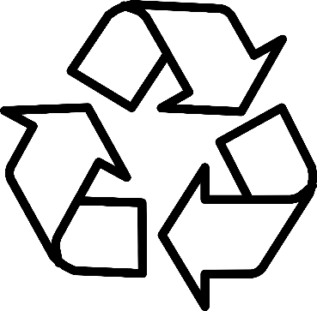
Recycling Aid
By Andrew Casey, Saadat Emilbekova, Dylan Jablonski, Jason Mele & Will Zakroff

Slide 2


Project Overview
What is the goal of our project?
Help people learn how to properly recycle by teaching people what each recycling material is and how you would recycle that material.
Why is our project socially relevant?
Our project is socially relevant due to it addressing the issues of pollution and waste, particularly due to the problem of improper recycling. Teaching people to correctly recycle, could lead to less waste and pollution as a whole.
What are the requirements (functionality) of your project?
Our functionality of our project was teaching recycling by letting users look up materials, calculate impact, play a recycling game, and simulate recycling behavior with different settings.

Slide 3
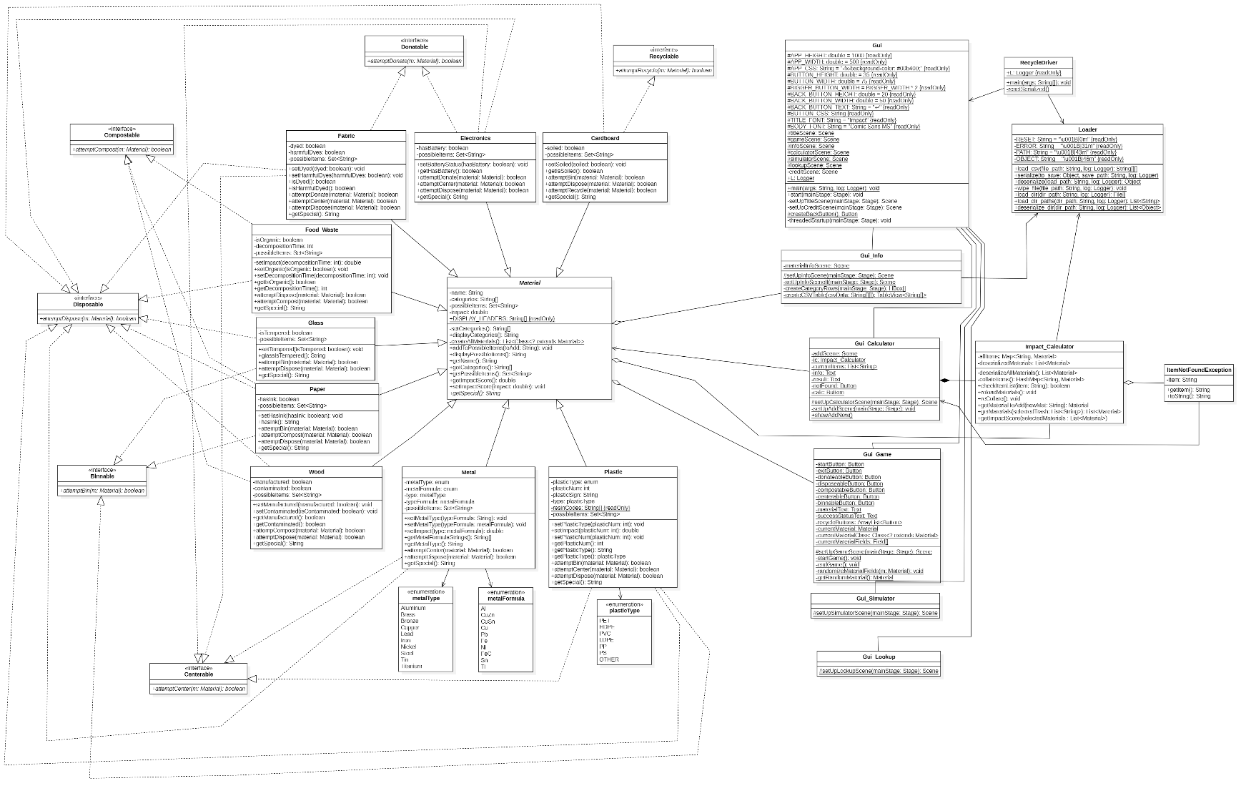
UML Class Diagram

Slide 4
UML Sequence Diagram

Slide 5

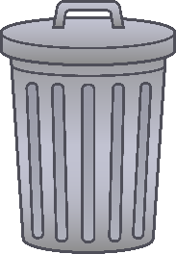
Polymorphic Collections
How did you use them in your application?
We use polymorphic collection in our project by generating random material subclasses like Paper and Glass. Even though they are different classes, they can be treated the same because they inherit from the Material class, which lets us store them together and work with them using shared methods.
What code demonstrates how you handled different object types?
In our code we have one method called attempt Recycle. Instead of checking exactly what kind of material it is , we checked what the material is able to do like if its compost, donate, and bin. This lets us recycle different materials.
How did you avoid coupling to subclasses?
Instead of checking the material’s exact class, we checking if it used an interface like Compostable or Binnable. This allows any material that can compost, bin, and add newer ones later without changing anything. In our project the code only care about what the material can do and not what class it is.

Slide 6
Abstract Classes and Interfaces
Where did you use abstract classes?
We used an abstract class called Material
Why did you use them?
We used the Material class to allow subclass to share common variables and methods for materials, and to prevent anyone from making a generic material object that isn’t specific like Paper or Plastic.
Where were interfaces used?
We had interfaces like Disposable and Compostable and they were used to describe what a material can do. Example: The Food_Waste subclass of Material implements Compostable, showing that any Food_Waste is compostable.
Did you have to use interfaces for your project?
Yes, we had to use interfaces in our project due to needing to check if something could be composted or disposable without needing to know the exact type of material subclass it is.
What were the advantages/disadvantages of using interfaces?
An advantage of using interfaces is it decoupled the code, where we didn’t need to know what class, a material was, we only needed to know what it could do. A disadvantage is some materials implement many interfaces; this makes them a little more complicated to set up.

Slide 7
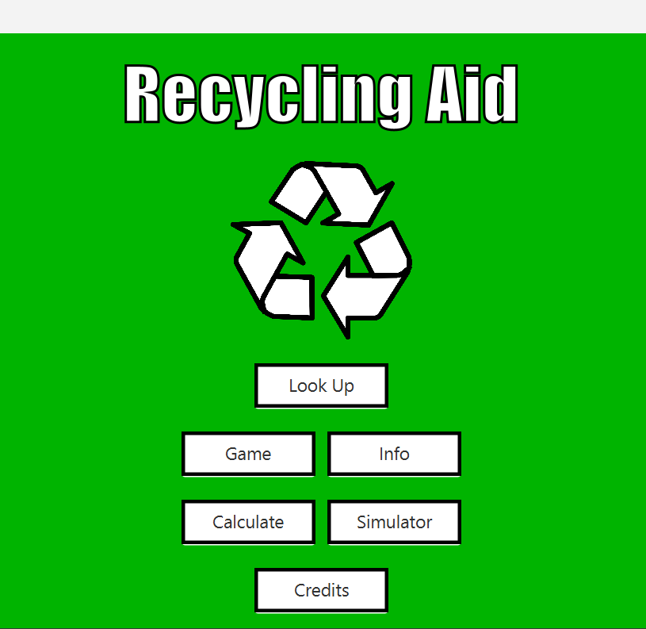
JavaFX GUI
What was the most challenging aspect of your GUI?
The most challenging part of the GUI was trying to manage all of the different user choices a user could pick and updating the screen correctly with proper information and without confusing the user.

Slide 8

Customized Error Handling
Where did you use it?
We used the custom exceptions when recycling a material failed, like when composting or disposing didn’t work
Did you like using it? Or did you feel it was overkill?
We liked using these exception due to it showing exactly what went wrong.

Slide 9
File Input/Output
What were your file input/output strategies?
In Gui_Info, we used file input to read data from categories.csv. This file would hold information about each interface like Binnable and Compostable that would show in the Info screen.
In our Gui_Calculator and Impact_Calculator, we used file input/output by serializing and deserializing Material objects. This allowed us to save java objects into a .txt file like plastic.txt and load them back later.
Where did you use serialization?
We used serialization when saving material objects into .txt files.
We use deserialization when loading the objects back from the files so you could calculate impact scores in the Calculator.

Slide 10

Use of logging
How and where did you use logging?
We used logging in our project to create a logger object called Gui.L. An example of where we use logging is in Gui_Game to log messages when buttons were clicked. This was used to help track users' actions.
Why did you implement this way?
We used logging this way because it was an easier way to see what a user what doing during the program and if any issues were occurring because of those actions.

Slide 11
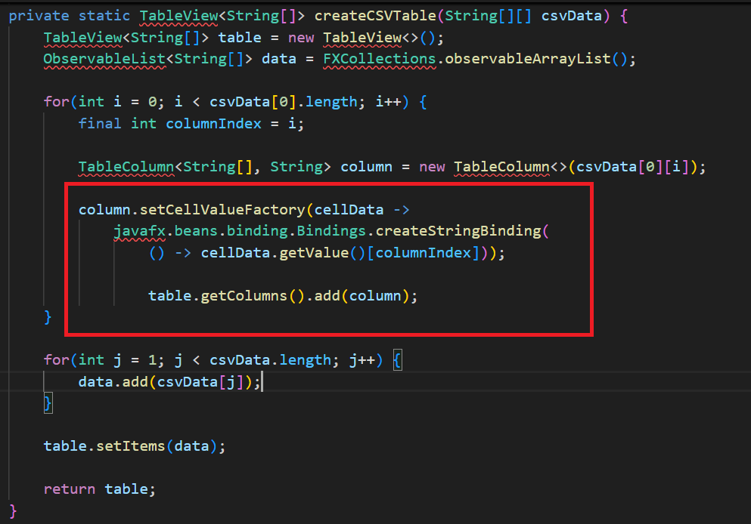
Lambda Expressions (beyond .forEach() and event handling)
Example
Explanation
In the red box we can see a lambda expression being used.
cellData -> is a lambda expression that creates dynamic behavior by telling the table how to pull the right value for each cell. The lambda replaces the need to create a full class to handle the cell data.

Slide 12
Design Patterns
Which design patterns did you use (if any) for this project?
Which design patterns would make sense for this project?
Consult with professor to see if this should be included.

Slide 13
Threads
How did you use multithreading in the project?
Consult with professor to see if this should be included.

Slide 14
Team Contributions
Jason: UML, Polymorphic Collections, Abstract class, JavaFX, File I/O, Logging, Threads, and Serialization.
Andrew Casey: Lambdas, Polymorphic Collections, JavaFX and Serialization.
Will Zakroff: Lambdas, Polymorphic Collections, JavaFX and Serialization.
Saadat Emilbekova: Polymorphic Collections, JavaFX
Dylan Jablonski: Polymorphic Collections, JavaFX, Sequence Diagram

